Slide 1
Meezy Cutz
Progress Report

Slide 2
Status
Approximately 90% done
Have main site almost done
CSS done
Database done
Login information done
Mainly Documentation and small editing left

Slide 3
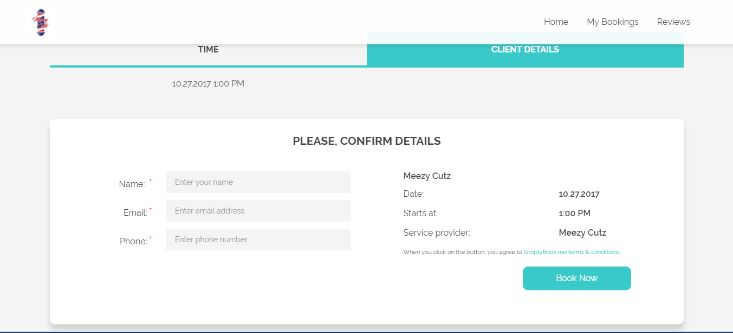
Login terminal

Slide 4
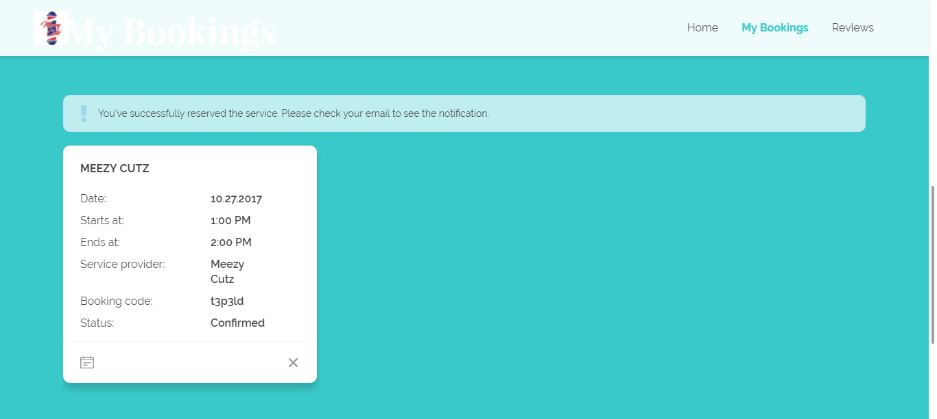
Login check

Slide 5
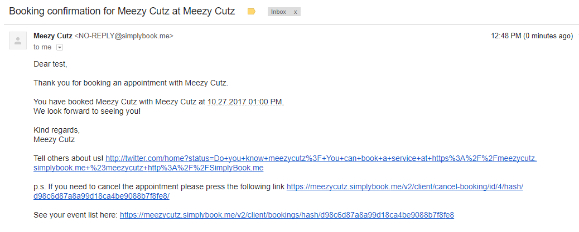
Appointment Confirmation Email

Slide 6
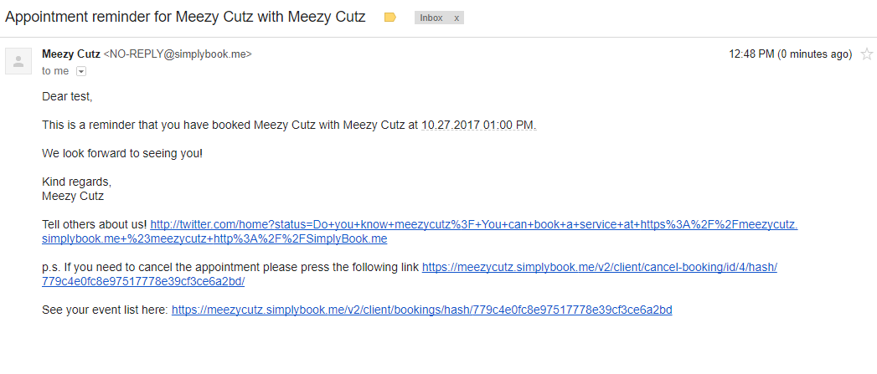
Appointment Reminder Email

Slide 7
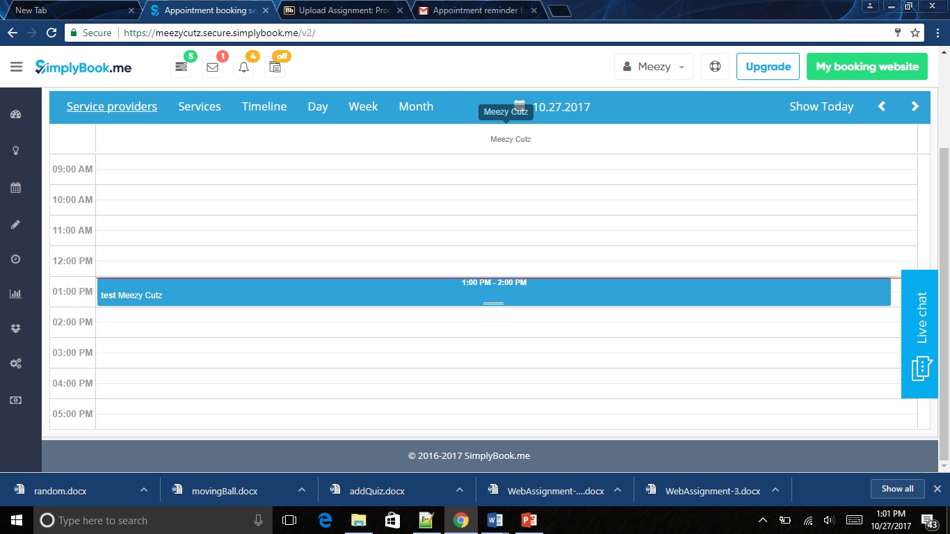
Admin Screen

Slide 8
The End

